Slide 1
WEB AND SOCIAL MEDIA ANALYTICS
CELL PHONE CUSTOMER REVIEW
Notes:
Objective

Slide 2
AGENDA
Objective
Background
Key findings
Recommendations
Appendix:
Data sources
Data methodology
Data model assumptions
Notes:
Objective

Slide 3
OBJECTIVE
To understand the competitors and customer preferences so that they can design their strategies accordingly.
To tweak the marketing strategies to add more value to their brand, provide features to customers that add the most value, and close the demand-supply gap
And most importantly, increase the market share as well as the brand value by developing a new product
Notes:
Objective

Slide 4
BACKGROUND
The industries are trying to fine-tune their strategies to suit the consumer needs, as the consumers leave some hints of their choices during their online presence.
Specifically in USA, the trends have been inconsistent with some countries showing an above average growth.
The company entered the mobile manufacturing market 3 years ago in the US, one of the major smartphones markets in the world.
Notes:
Objective

Slide 5
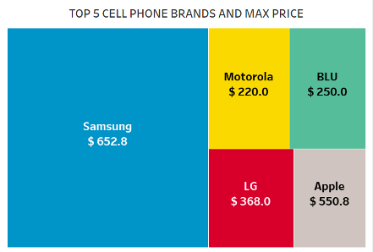
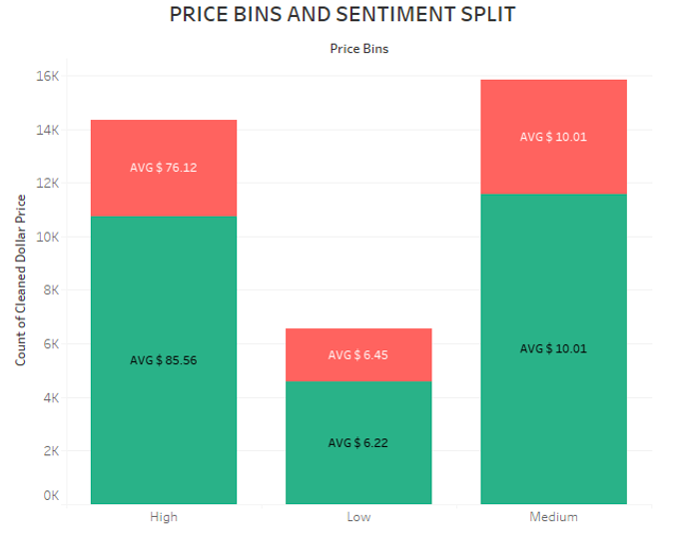
SAMSUNG: THE BIGGEST PLAYER IN THE CELL PHONE MARKET
The top 5 cell phone brands are Samsung, Motorola, BLU, LG and Apple and their max price are between $220 - $650
Most expensive phones are approximately 5 times costlier than the average “high priced” cell phones
Other than Apple, all the top brands are Android based Operating Systems
Notes:
Objective

Slide 6
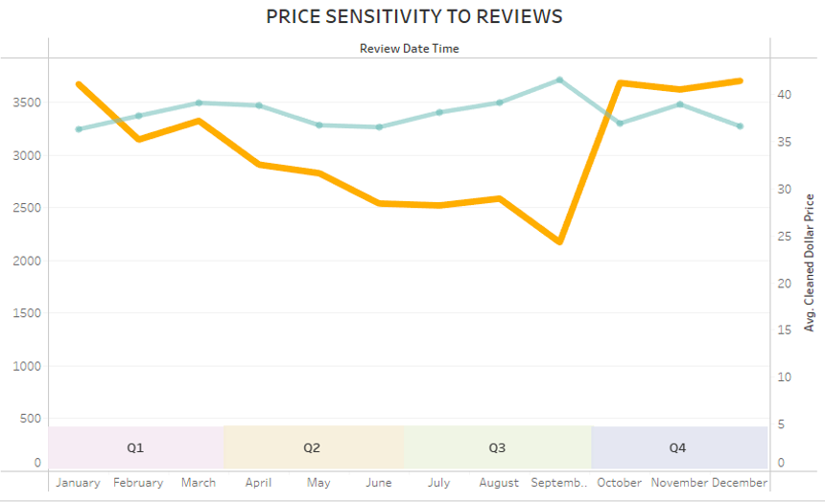

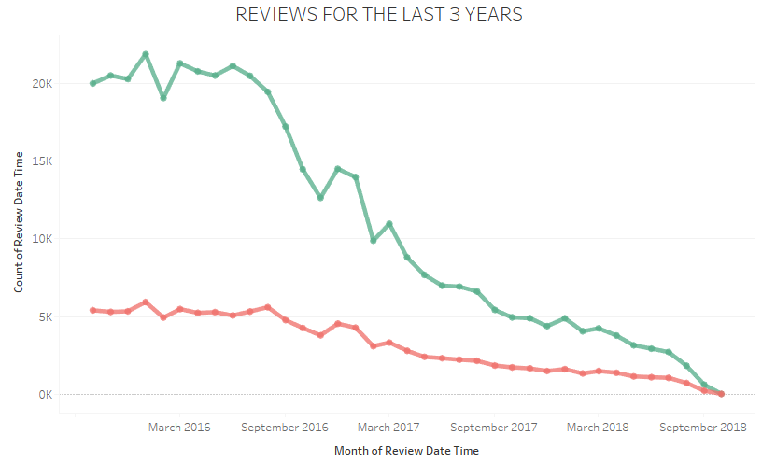

DECREASING TREND IN REVIEWS IN THE LAST 3 YEARS
Overall, there is a substantial decline in number of reviews, which could be due to customers may increasingly choose not to review products
In Jan 2016, the review count was the highest in the last 3 years (since Oct 2015) at 27,914.
Quarterly trends indicate reviews drastically reduce in the Q3 over the years while there is an incline in average price in same period.
Notes:
Objective

Slide 7
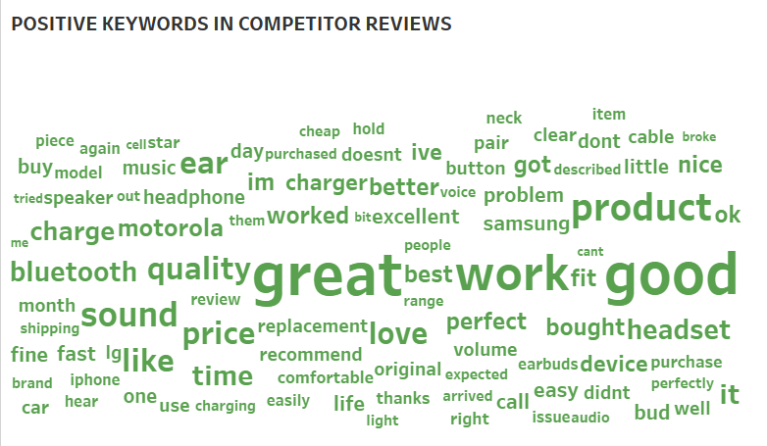
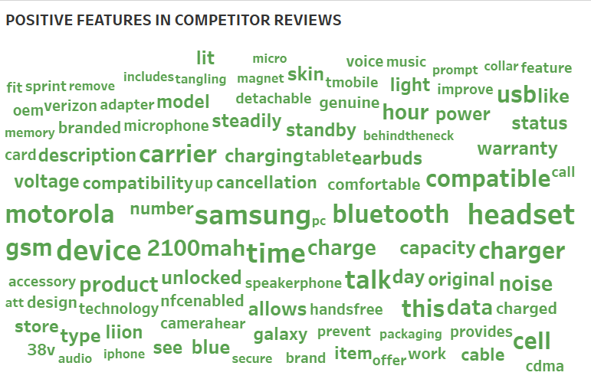
QUALITY PERFORMANCE IS THE BIGGEST SELLING POINT
From customer reviews most of the positive feedback is toward the audio-visual features (camera, video, sound, screen) of the cell phones.
Positive features show that the software of the cell phones are the biggest selling points like compatibility, processor, android, quadcore, etc.
Most customers are android users as per market share and prefer brands that use it as their operating system.
Notes:
Objective

Slide 8
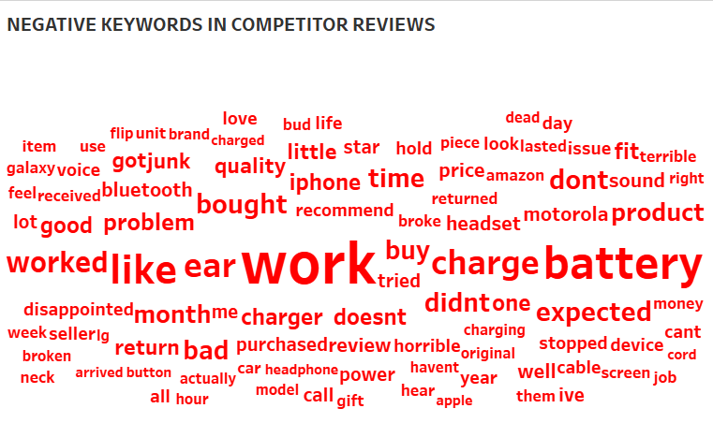
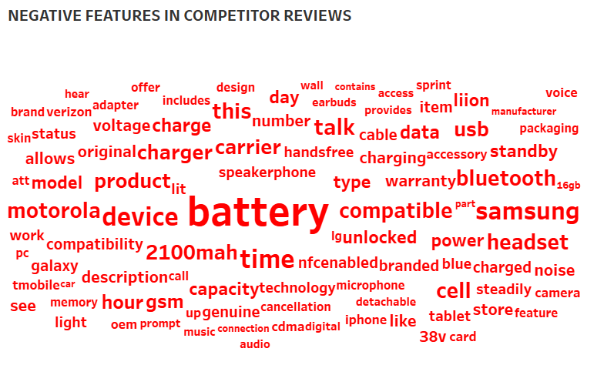
TOP 5 CELL PHONE BRANDS HAVE CHARGING ISSUES
The top cell phone brands seem to have battery or charging related issues.
From customer reviews most of the negative feedback is toward the battery and charging cables.
Negative features also show that the battery, USB cable and charger being mentioned more than 20,000 times.
Notes:
Objective

Slide 9
RECOMMENDATIONS
Develop high performance products that are priced below $350
Focus efforts on marketing and advertising in Q3 which has lowest sales
Gain market edge by capitalizing on improving battery life and charging
Notes:
Objective

Slide 10
APPENDIX - DATA SOURCES:
Here is a snapshot of our data dictionary.
Customer feedback such as reviews, verification and overall ratings.
Product information such as brand, category, price, and features.
The following data sources were used:
Product meta data from Amazon
Customer feedback data from Amazon product reviews and ratings
Notes:
Objective

Slide 11
APPENDIX - DATA METHODOLOGY
A thorough analysis of the data set. The process included:
Cleaning the data set for quantitative and text analytics
Using pre-processing methods to fix null values and remove outliers
Creating a word clouds to understand customer preferences
Notes:
Objective

Slide 12
APPENDIX - DATA ASSUMPTIONS
There were certain steps needed to be taken due dated excessive data as well as mismatched information.
We need to gain insights into the latest market trends, therefore data analyzed was of the past 3 years (2015-10-02 to 2018-10-02)
Price column contained 37% null values which were filled with median price
Since we needed to only get insights related to cell phones, analysis was conducted on “cell phone and accessories” as the only category
Notes:
Objective

